Slide 1
British Airways
Task 2
-Samudra Roy

Slide 2
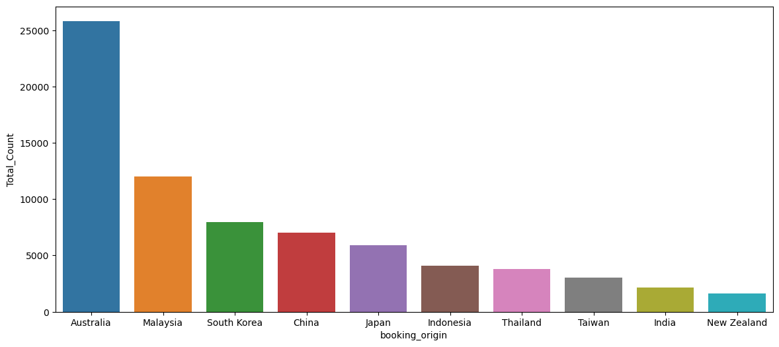
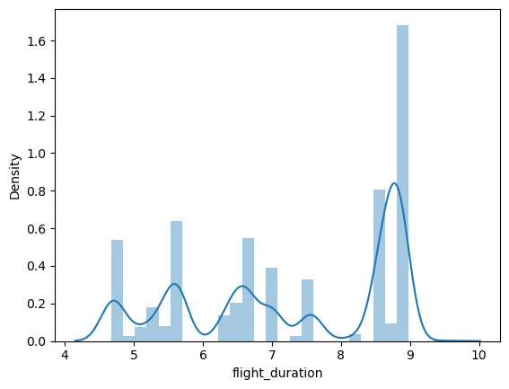
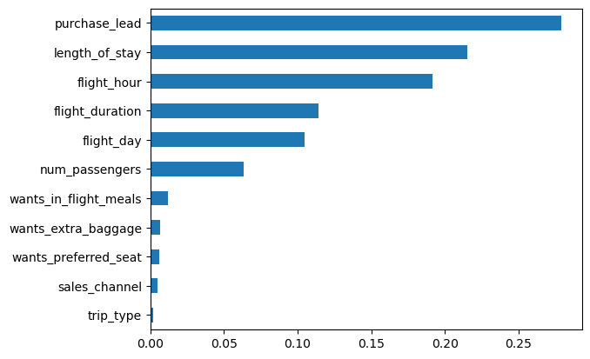
Australia produces the most number of passengers.
Most passengers take flight for 8-9 hours.
The Random Forest model gives the most accuracy of 84%.

